Slide 1
Cave Adventure
An Adventure Inc. Project
Shannon Ding, Ronit Mathur, Jessabelle Ramos

Slide 2
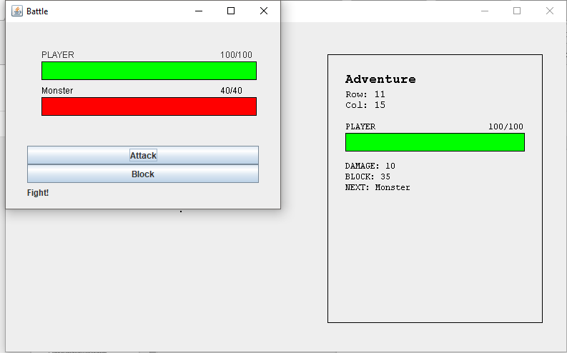
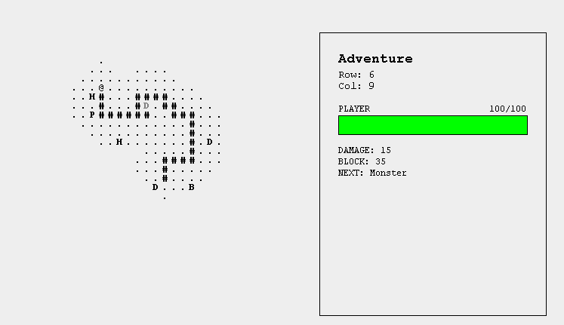
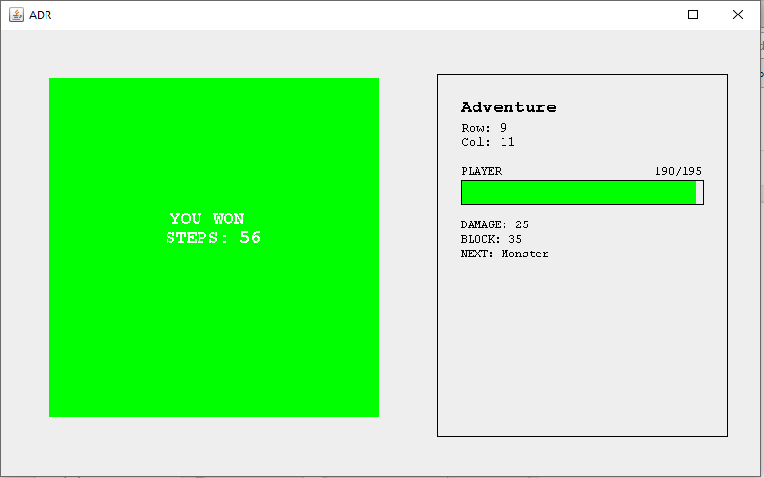
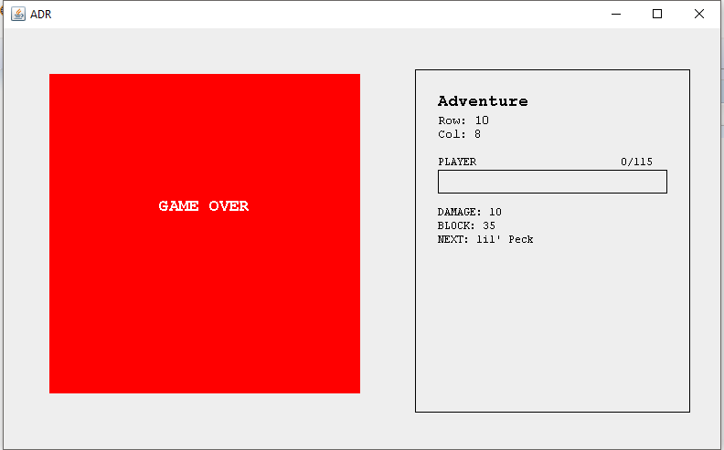
Cave Adventure
Fight monsters
Explore the cave!
Escape. . .
. . . or die trying

Slide 3
What & Why
A Dark Room Map-inspired, Minimalistic top-down game
Allows for User-interpretation
More focus on game function rather than graphics
Skips long intro for A Dark Room
Main Objective: Find the exit in as few steps as possible
Notes:
Jessabelle ? Or Ronit

Slide 4
Development Process

Slide 5
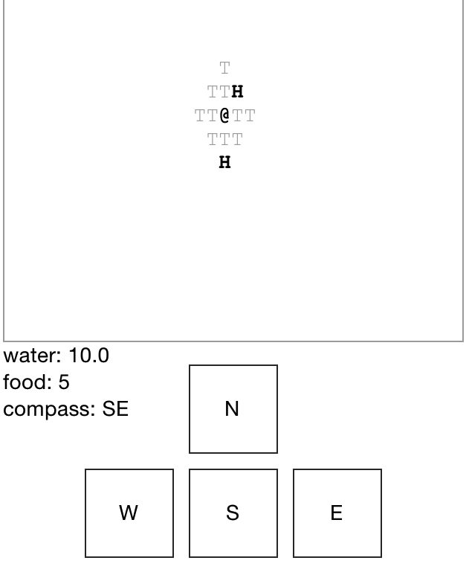
Vision
Map made of symbols, much like A Dark Room
Countdown battles
Scavenger hunt
Specific spawn points for obstacles determined at start of game
Turn-based battles
Cave exploration to find the exit
Upgrades to player
Chance-based monster spawns
A Dark Room
Notes:
Ronit?
Sacrifices were made for the sake of smoother gameplay

Slide 6
Classes
Generating a World Map:
Square
WorldMap
WorldMapSquare
Movement and Mechanics
AdventureViewer
Open JFrame
AdventureComponent
Draw
AdventureFrame
Set JFrame
Battles:
BattleComponent
Drawings
BattleFrame
Open JFrame
BattleControls
GUI attacks and blocking

Slide 7
Data Structures Used
Queues & LinkedLists
Determines order of monster spawns (Difficulty of monsters)
2D Arrays and For-Loops
Map generation
GUI
JLabel, JButton, JFrame, JPanel
Used to create a battle window with health bars and buttons for blocking and attacking
Used for the WorldMap

Slide 8
Development Reflection
Successes:
Finished on time, met proper functionalities and requirements
Implemented new and original aspects of the game, such as health bars
Failures:
Finished product much different from original plan
JUnit Testing felt rushed during the final week
What We Learned:
Plan ahead with time and ability constraints in mind
More accurately predict difficulty of certain aspects of what we want to accomplish, plan accordingly (i.e. consider AP testing)
Notes:
*insert before vs after**
spawning on specific, predetermined points on the map >>> spawn rates for each monster, with each step user takes >triggered
Timer-based attack and blocking >> turn-based with percentage-chance blocking
+blocking gains health
Our development process, in terms of success and failures, was characterized by how well we stuck to our original design plan and the sacrifices we made to make a more cohesive game.

Slide 9
How to Play!
Run AdventureViewer.java
Use WASD to control your character (Signified by the @) and explore the map
Step on various letters to increase stats!
P restores 50 hp ; H restores increases max health; etc
Fight monsters!
When entering a battle, a new window is opened.
Use the Attack and Block buttons to defend yourself!
Find the green E. That’s the exit!
Play again and try to beat the game in less steps!
Notes:
Jessabelle
2. Spaces you have already visited change to a # and don’t spawn new monsters
4. Click the Attack button to fight the monster.
Click the Block button for a chance to stop a Monster’s attack and heal yourself!

Slide 10
Demonstration!
Thank you!

